Slide 1
ADAS system
AVR Final project
YousSef samy Mahmoud Osman

Slide 2
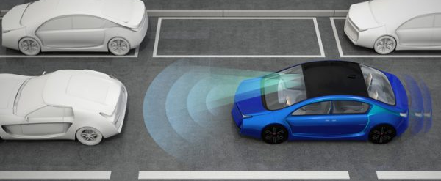

Slide 3
security ECU
The security ECU is designed to enhance vehicle security by requiring a password before each start.
Password Verification: The ECU is connected to a keypad where users must enter a password. The correct password is stored in the EEPROM as '1', '2', '3', '4'.
User Input: After entering the password, the user presses the '=' button to confirm.
Password Matching: The ECU compares the entered password with the stored password.
If the password is correct:
A green lamp lights up for 700 ms.
A servo motor rotates to +90 degrees and then returns to 0 degrees after 1 second.
The ECU sends the character 'A' via UART.
If the password is incorrect:
A red lamp lights up for 700 ms.

Slide 4
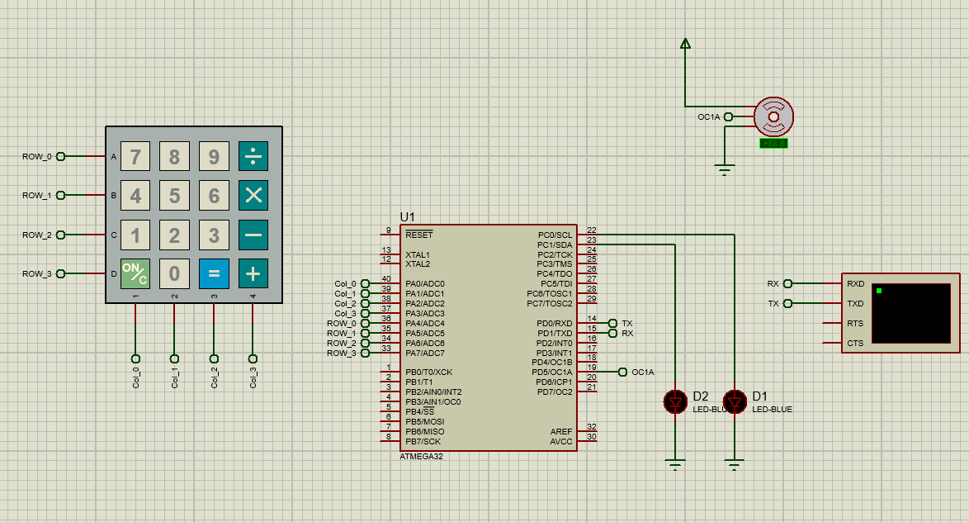
security ECU

Slide 5
Control ECU
The Control ECU manages various subsystems in a vehicle, all of which remain off until the ECU receives an 'A' character from the security ECU.
1. Brake Assistant System (BAS):
Default State: Off, because the gearbox is in 'N' by default.
Activation: Turns on when the gearbox is shifted to 'D' and turns off when shifted to any other gear.
Operation:
Uses an ultrasonic sensor to measure distance.
Distance > 10 cm: BAS LED is off.
Distance > 5 cm: BAS LED toggles every 100 ms.
Distance ≤ 5 cm: BAS LED is on.

Slide 6
Control ECU
2. Speed Limiter System (SL):
Default State: Off, because the gearbox is in 'N' by default.
Activation:
Turns on when the gearbox is in 'D' and the SL push button is pressed.
Turns off when the gearbox is not in 'D' or if the SL push button is pressed again.
Operation:
SL LED is on when the system is active.
Display: "SL: ON" or "SL: OFF" is printed on the LCD depending on the SL status.

Slide 7
Control ECU
3. Cross Control System (CCS):
Default State: Off, because the gearbox is in 'N' by default.
Activation:
Turns on when the gearbox is in 'D' and the CCS push button is pressed.
Turns off when the gearbox is not in 'D', the CCS push button is pressed again, or the gas potentiometer is adjusted.
Operation:
CCS LED is on when the system is active.
Display: "CCS: ON" or "CCS: OFF" is printed on the LCD depending on the CCS status.

Slide 8
Control ECU
4. Kilometer Counter:
Operation:
Displays the kilometer value on the LCD.
The value increments faster with higher gas potentiometer input and slower with lower input.

Slide 9
Control ECU
5. Drive Monitoring:
Default State: Off, because the gearbox is in 'N' by default.
Activation:
Turns on when the gearbox is in 'D' and turns off otherwise.
Operation:
Uses Timer2 in overflow mode to monitor driver activity.
If there is no change in the system for 5 seconds, the buzzer toggles every 100 ms.
Any system change resets the 5-second timer.

Slide 10
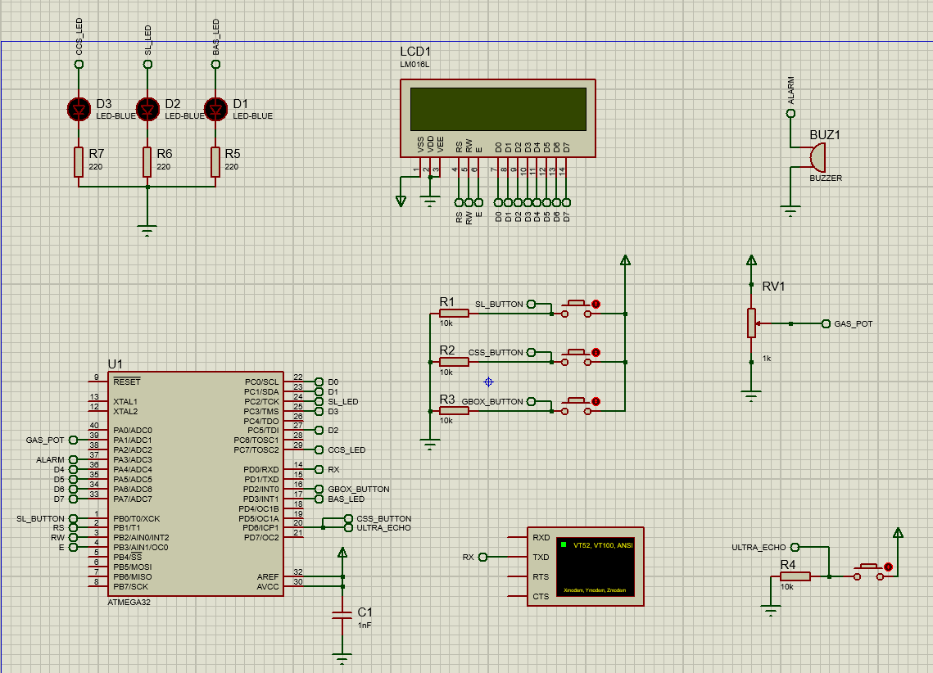
Control ECU

